Slide 1
CUHK MSC Fintech FTEC 5910 Industrial Project Final Presentation Project Sponsor: Bank of Communications Co.,Ltd. Hong Kong Branch Topic: Large Language Model Building for Bankwise Processes Author: Wong Ko Yin
Academic Supervisor: Prof. Irwin King
Industrial Supervisor: Mr. Nathan Wong Ms. Ping Yuen

Slide 2
Background
Bell was launched in 2018 as an internally developed chatbot by Bank of Communications (BOCOM) R&D team.
The R&D team plans to integrate Generative AI into Bell to advance the bank’s AI capabilities.
BOCOM’s Expectations:
Compare the ability and strength of various open-source LLMs
Implement the prototype for bankwide processes by leveraging RAG and LLM
The prototype should be focusing on the document searching and FAQ as the major use cases
Data set: HKMA Supervisory Policy Manual (in both Chinese and English)

Slide 3
Objectives
Goal:
Develop a secure Retrieval-Augmented Generation (RAG) chatbot system enabling bankers to efficiently query private internal documents and finance-related regulatory policies.
Technical:
Incorporate Retrieval-Augmented Generation (RAG) techniques and Large Language Models (LLMs) to retrieve information and regulatory requirements efficiently.

Slide 4
Risk and Challenges for Existing Open-source Chatbot System
Language Proficiency Risk:
LLMs used for those system are primarily trained on English datasets and often underperform on Chinese tasks.
Data Privacy Risk
They usually used Closed-source or cloud-based LLMs that may expose sensitive internal documents, creating confidentiality concerns
Domain-Specific Knowledge Challenge
LLMs used for those system may not have sufficient training on banking-specific terminology or regulatory requirements

Slide 5
Hardware for this Project
Component | Specification | Impact
Accelerator | 4x NVIDIA 1080Ti GPUs | Limited VRAM may increase response time for: Multiple interactions with the LLM Large token inputs during queries
GPU VRAM | 11,264 MB x 4 =~45 GB | Insufficient CUDA memory for running or fine-tuning large-size LLMs (e.g., Llama 3.2 90B, Qwen 2.5 72B)
Motherboard Memory | 900 GB | Adequate for storing multiple LLMs and datasets handing
Hardware Provider: CUHK Fintech Department

Slide 6
Solutions to the Risks and Challenges
Chinese Dataset Compatibility
Use LLMs trained on Chinese datasets to ensure high performance in Chinese retrieval tasks.
Perform experiments to benchmark their effectiveness
Data Privacy Assurance
Deploy open-source LLMs on local servers to prevent sensitive data from being exposed to external providers
Retrieval-Augmented Generation (RAG)
Reduces hallucination by grounding the LLM’s outputs with relevant information
Hardware Optimization
Adapt smaller parameter-sized LLMs that fit within the GPU resources available at CUHK Fintech

Slide 7
Step-by-Step Development Progress
Term 1:
Experiment 1: Comparison of Open-Source LLMs to ensure the selection of a model suitable for Chinese RAG tasks.
Experiment 2: Comparison of RAG Framework to identify the most effective retrieval mechanism for document search.
Term 2:
LLM Fine-Tuning to adapt the selected model to the domain-specific requirements of Finance and Banking
Prototype Development to ensure a functional chatbot system for real-world testing in BOCOM’s environment

Slide 8

Experiment 1:

Slide 9
Description
Objective: Judge whether the retriever can correctly retrieve the document
Test Set: 90 Questions for 9 PDFs
Methodology:
Retrieve the relevant document for each question
Evaluation Metrics (Hit rate)
Goal: Select the best RAG framework for this chatbot system

Slide 10
Retriever
Embedding Model: Chuxin-Embedding
Model Size: 568M parameters
Search Type: Use similarity-based search to retrieve the most relevant document chunks.
Chunks: Split by pages

Slide 11
Dataset
Source: HKMA Supervisory Policy Manual
Finance Regulatory Domain
Language :
7 in Chinese, 2 in English
Mainly Chinese with small proportion of English Content
Memory Size: 5 MB
Tokens Count by Retriever:
317,440 tokens
Dataset is selected by project sponsor
Topic | Language | Pages | Tokens
Corporate Governance of Locally Registered Authorized Institutions | Chinese | 38 | 38912
Climate Risk Management | English | 35 | 35840
Guidelines on Combating Money Laundering and Counter-Terrorist Financing | Chinese | 83 | 84992
Risk-based Regulatory System | Chinese | 30 | 30720
Outsourcing | Chinese | 14 | 14336
Regulatory Approach to Combating Money Laundering and Terrorist Financing | Chinese | 20 | 20480
Risk management of electronic banking | English | 37 | 37888
General Principles of Technology Risk Management | Chinese | 29 | 29696
Continuing business operations planning | Chinese | 24 | 24576
Total |  | 310 | 317440

Slide 12





Experiment 1:
Comparison of Open-Source LLMs

Slide 13
Description
Objective: Conduct a comprehensive comparison of various open-source LLMs to evaluate their performance in RAG tasks.
Test Set: 27 Questions
3 questions generated from each of the 9 PDFs in the dataset.
Methodology
RAG & No RAG (Baseline)
Evaluation Metrics
Accuracy (METEOR) & Efficiency (Response Time)
Goal: Select the best 3 LLMs on RAG task for future progress

Slide 14
Large Language Models
 | Llama 3.2 | Gemma 2 | Qwen 2.5 | Yi 1.5
Company: | Meta AI (US) | Google (US) | Alibaba Cloud (China) | 01-AI (China)
Released Date | 09/2024 | 06/2024 | 09/2024 | 05/2024
Model Size: (billion) | 1b/3b/11b | 2b/9b | 0.5B/1.5B/3B/7B | 6b/9b
Maximum Tokens | 128,000 | 8192 | 3,200/128,000 | 128,000
Supported Language (Official) | English | English Chinese | English Chinese | English Chinese
For model size: Only limited models can be used in this experiment due to hardware limitation
For Llama 3.2, although this model series officially does not support Chinese. However, this model is trained by a large collection of languages which includes Chinese.

Slide 15
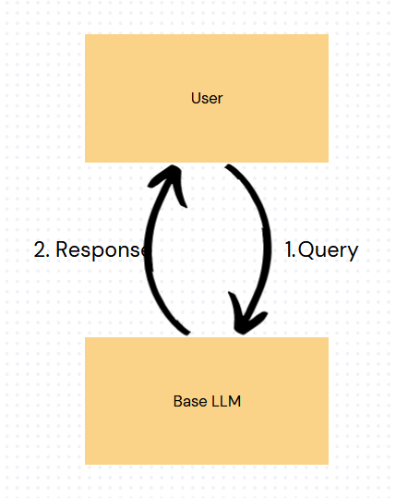
Methodology: No RAG (Baseline)
Summary: Generate responses without incorporating external document retrieval.
Role:
Serves as the baseline to compare performance with the RAG approach.
Help to evaluate how much RAG method improves the model's accuracy on finance regulatory task

Slide 16
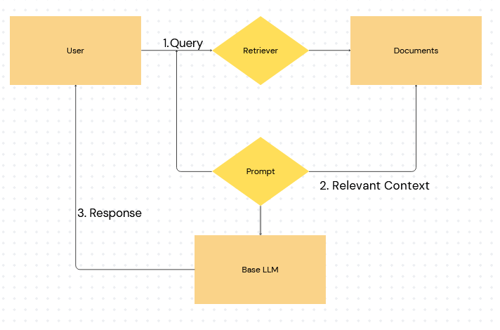
Methodology: RAG
Summary: Generate responses based on retrieved context.
Role:
Evaluates how much RAG method improves model performance for accuracy and efficiency

Slide 17
Prompt Template
No RAG (Baseline) | RAG
“”” 使用不超過200字繁體中文(連標點) 來回答問題。 Question: {question} Answer: | “”” 使用不超過200字繁體中文(連標點) 回答所給的上下文來回答問題。 上下文: {Relevant context} Question: {question} Answer:
For RAG prompt, each model shares the same relevant document for each question

Slide 18
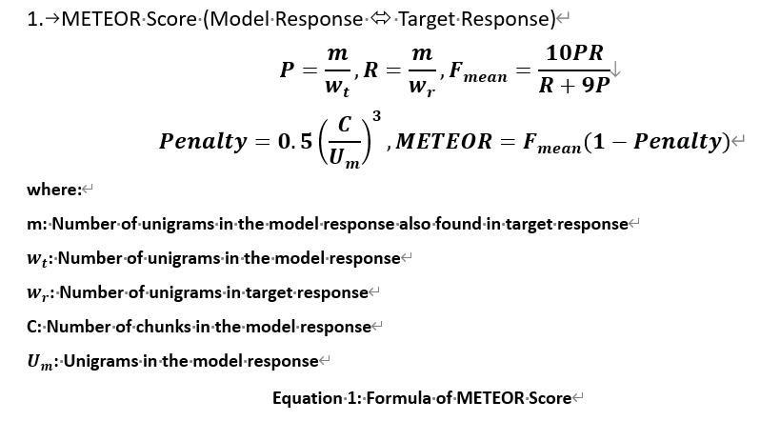
Evaluation Metrics
Accuracy: Metric for Evaluation of Translation with Explicit Ordering (METEOR)
Efficiency: Response Time

Slide 19
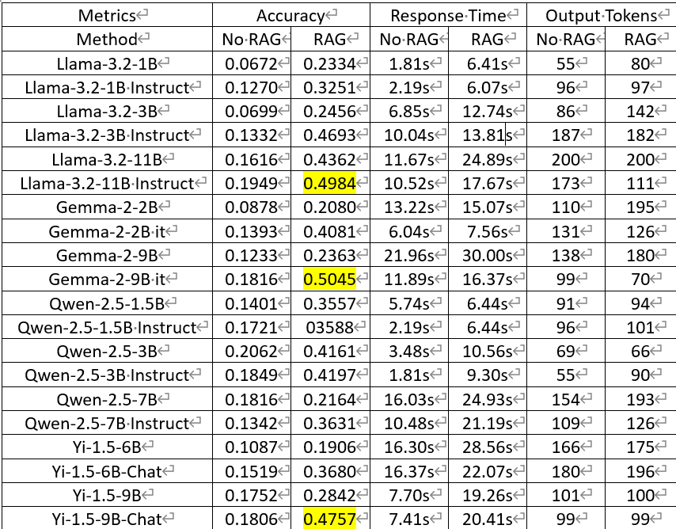
Result
Input tokens for all LLMs are the same

Slide 20
Example
Question
電傳轉帳是甚麼?
Retrieved context: Top 3 chunks
電傳轉帳是由一間機構(匯款機構)代表某人(匯款人)藉電 子方式進行的交易，目的是將某筆金錢轉往某間機構(收 款機構) (該機構可以是匯款機構或另一機構)以提供予 該人或另一人(收款人)，而無論是否有一間或多於一間 其他機構(中介機構)參與完成有關金錢轉帳。
認可機構 應就其在電傳轉帳中扮演的⻆色，遵從本章所載的相關規定
如認可機構是電傳轉帳的匯款人或收款人，即並非以匯款機構、中介機構或收款機構的身分行事，則無需就該交易遵守附表2 第12 條的規定或本章的指引。

Slide 21
Example
Model | Gemma 2 9B it |  | Llama 3.2 11B Instruct |  | Yi 1.5 9B Chat
Question | 電傳轉帳是甚麼?
Target Response | 電傳轉帳是由一間機構代表某人藉電子方式進行的交易，目的是將某筆金錢轉往某間機構以提供予該人或另一人，而無論是否有一間或多於一間其他機構參與完成有關金錢轉帳。
Method | No RAG | RAG | No RAG | RAG | No RAG | RAG
LLM Response | 電傳轉帳，簡稱電匯，是一種通過銀行電訊網路進行資金轉移的方式。 它比傳統的支票或匯票更快更有效率，因為資金幾乎是即時轉帳的。 你需要提供收款人的銀行帳戶資訊，例如帳號、銀行名稱、SWIFT代碼（國際銀行識別碼）等等，才能完成電匯。 電匯通常會收取一定的費用，費用會根據轉帳金額和銀行而有所不同。 總之，電匯是一種方便快捷的國際或國內資金轉帳方式。 | 電傳轉帳是一種電子交易方式。匯款機構代表匯款人，將款項透過電子方式轉到收款機構（可能是匯款機構本身或其他機構），最終交付給收款人。過程中可能涉及其他中介機構參與。 認可機構若僅作為匯款人或收款人，而非扮演匯款機構、中介機構或收款機構的角色，則無需遵守相關規定。 簡單來說，電傳轉帳就是一種電子化的資金轉移方式。 | 電傳轉帳是一種電子支付方式,用於轉移電子金錢。它允許用戶跨銀行或支付系統進行即時電匯交易,簡化了傳統匯款流程。 | 電傳轉帳是由匯款機構代表匯款人以電子方式進行的交易，將資金從一個國家的銀行帳戶轉至另一個國家的銀行帳戶，通常透過SWIFT系統完成，具備快速和安全的特點，但可能涉及手續費。如果認可機構是以匯款人或收款人的身分進行電傳轉帳，而非作為匯款機構、中介機構或收款機構，則無需遵守附表2第12條的規定或相關指引。整個過程可包括一間或多間中介機構協助完成資金轉移。 | 電傳轉帳是一種透過電子網路將資金從一個銀行帳戶轉移到另一個銀行帳戶的付款方式。它是一種快速、安全且方便的轉帳方式，通常比傳統的支票或現金轉帳更快。電傳轉帳通常需要提供轉帳人的銀行帳戶資訊，例如帳戶號碼和銀行代碼，以及收款人的銀行帳戶資訊。 | 電傳轉帳是指透過電子方式，由一間機構代表某人將金錢轉往另一機構，以提供給特定收款人。
METEOR | 0.1518 | 0.2902 | 0.1097 | 0.3145 | 0.1706 | 0.2625

Slide 22
Discussion (LLMs Comparison)
Top 3 LLMs on RAG Accuracy:
Gemma 2 9B it
Llama 3.2 11B Instruct
Yi 1.5 9B Chat
Instructed-tuned models generally have better accuracy in both no-rag and rag tasks than their base model
200 maximum output tokens maybe proper
Since top three LLMs on RAG accuracy do not have the largest output tokens

Slide 23
Discussion (No RAG vs RAG)
No RAG Response (Baseline):
Generally have lower accuracy and higher efficiency than RAG
Limited Knowledge
Relies only on the LLM’s pre-trained knowledge
Example: Struggles to provide precise details about "telegraphic transfer" without external context.
RAG Response:
Generally have higher accuracy and lower efficiency than RAG
Incorporates Relevant Context
Retrieves domain-specific documents to ground the LLM’s responses
Example: RAG responses included precise explanations about telegraphic transfers by leveraging retrieved content.

Slide 24
Limitation of Basic RAG Method
Faithfulness: The response may omit key details from the retrieved content
E.g. Response from Llama (RAG) the potential involvement of intermediary institutions ("中介機構"). It only partially explains the roles of remitting and receiving institutions.
Missing key elements lowers recall, as the response fails to include all relevant details present in the target response Limited Knowledge
Answer Relevant:The response maybe verbose, over-elaborating on intermediary institutions and roles. Incorporates Relevant Context.
E.g. "中介機構也可能參與" in Llama (RAG) (intermediary institutions may also participate) is accurate but unnecessarily elaborated.
Verbose responses include extraneous content that reduces precision and alignment with the target response's brevity.

Slide 25
Experiment 2:
Comparison of Different RAG Methods

Slide 26
Description
Objective: Comparison of different RAG frameworks to enhance the overall performance of the chatbot system
Test Set: 27 Questions (Same as experiment 1)
Methodology
RAG alternatives
Evaluation Metrics
Accuracy, Efficiency (Same as experiment 1)
Generation Qualities (Faithfulness & Answer Relevant)
Goal: Select the best RAG framework for this chatbot system

Slide 27
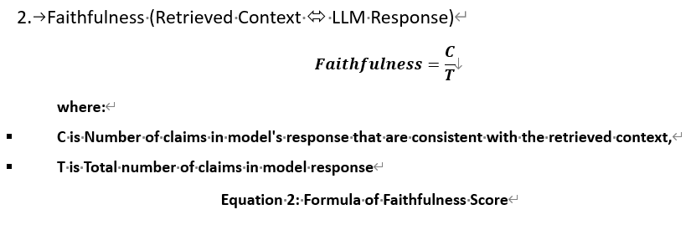
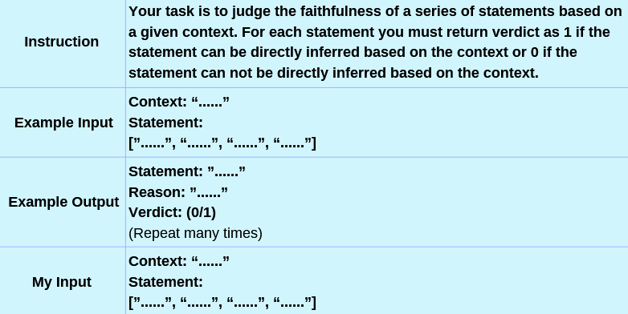
Evaluation Metrics
Generation Quality (Faithfulness) Formula:
Prompt to use LLM as Judge
Use LLM as Judge (GPT 3.5)
Range from 0 to 1
1 indicates that all claims in LLM's response can be inferred from the given context
Lower value represent how inconsistent the model's response is from the given context

Slide 28
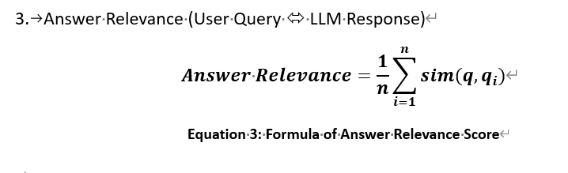
Evaluation Metrics
Generation Quality (Answer Relevant) Formula:
Use Cosine Similarity to calculate the similarity score
Range from 0 to 1
1 indicates that all claims in LLM's response can be inferred from the given context
Lower value represent how inconsistent the model's response is from the given context

Slide 29
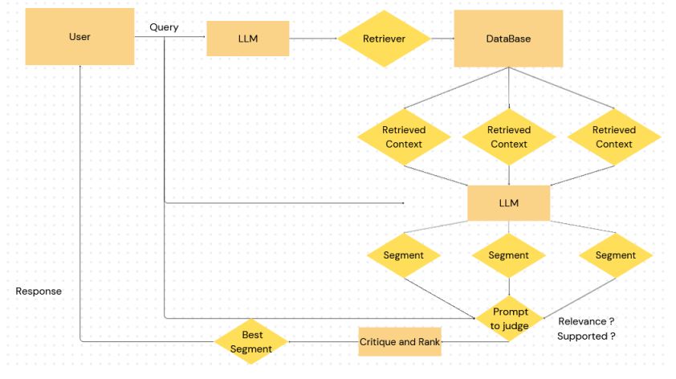
Methodology: RAG
Summary:
Generate responses based on each retrieved context
Iterative self-evaluation based on whether the response is supported by retrieved context and relevant to user’s query
The best-ranked segment is used as the final response

Slide 30
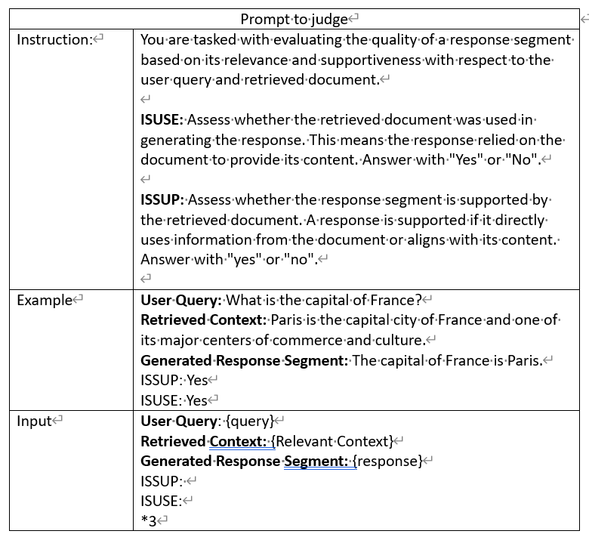
Methodology Self-Reflective RAG Prompt to use LLM to judge whether their responses are supported by the retrieved context or relevant to the answer

Slide 31
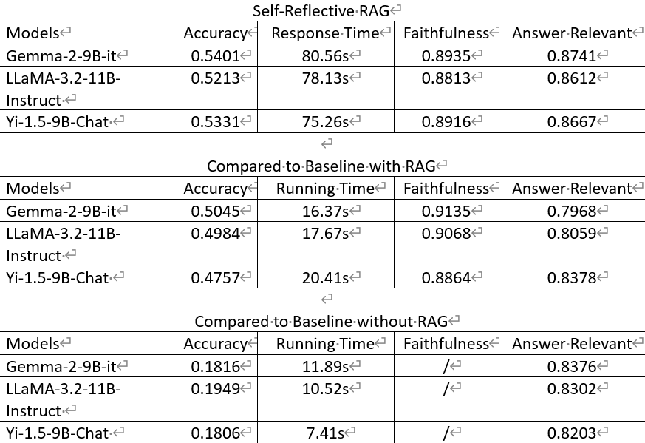
Result

Slide 32
Example
Model | Gemma 2 9B it |  | Llama 3.2 11B Instruct |  | Yi 1.5 9B Chat
Question | 電傳轉帳是甚麼?
Target Response | 電傳轉帳是由一間機構代表某人藉電子方式進行的交易，目的是將某筆金錢轉往某間機構以提供予該人或另一人，而無論是否有一間或多於一間其他機構參與完成有關金錢轉帳。
Method | RAG | Self-RAG | RAG | Self-RAG | RAG | Self-RAG
LLM Response | 電傳轉帳，簡稱電匯，是一種通過銀行電訊網路進行資金轉移的方式。 它比傳統的支票或匯票更快更有效率，因為資金幾乎是即時轉帳的。 你需要提供收款人的銀行帳戶資訊，例如帳號、銀行名稱、SWIFT代碼（國際銀行識別碼）等等，才能完成電匯。 電匯通常會收取一定的費用，費用會根據轉帳金額和銀行而有所不同。 總之，電匯是一種方便快捷的國際或國內資金轉帳方式。 | 電傳轉帳，簡稱電匯，是一種透過電子方式進行的資金轉移。 匯款人委託匯款機構，將款項轉給收款機構，再由收款機構交付給收款人。過程中，可能會有其他中介機構參與，但最終目的是將資金從匯款人轉到收款人手中。 它是一種快速且便捷的國際或國內資金轉帳方式 | 電傳轉帳是由匯款機構代表匯款人以電子方式進行的交易，將資金從一個國家的銀行帳戶轉至另一個國家的銀行帳戶，通常透過SWIFT系統完成，具備快速和安全的特點，但可能涉及手續費。如果認可機構是以匯款人或收款人的身分進行電傳轉帳，而非作為匯款機構、中介機構或收款機構，則無需遵守附表2第12條的規定或相關指引。整個過程可包括一間或多間中介機構協助完成資金轉移。 | 電傳轉帳是一種交易方式, 由一間機構(匯款機構)代表某人(匯款人)藉電子方式進行的交易, 目的是將某筆金錢轉往另一間機構(收款機構)以提供予該人或另一人(收款人), 而無論是否有一間或多於一間其他機構(中介機構)參與完成有關金錢轉帳。 | 電傳轉帳是指透過電子方式，由一間機構代表某人將金錢轉往另一機構，以提供給特定收款人。 | 電傳轉帳是一種透過電子方式，由匯款機構代表匯款人將金錢轉至收款機構，提供給收款人或另一人，無論是否透過中介機構完成的交易。
METEOR | 0.1518 | 0.3094 | 0.3145 | 0.8386 | 0.2625 | 0.3703
Faithfulness | 0.5000 | 0.6667 | 1 | 1 | 1 | 1
Answer Relevant | 0.6400 | 0.6634 | 0.6418 | 0.6958 | 0.7584 | 0.7090

Slide 33
Discussion (RAG vs Self-Reflective RAG)
Generation Quality (Faithfulness):
Self-reflective RAG is not likely to improve the faithfulness
2 models have lower faithfulness score when using self-reflective RAG
Generation Quality (Answer Relevance):
Consistently better with Self-RAG
All 3 models have higher relevant score when using self-reflective RAG
Accuracy (METEOR Score):
Self-reflective RAG ensures higher accuracy
All 3 models have higher accuracy when using self-reflective RAG

Slide 34
Discussion (Self-Reflective RAG)
Advantage: Improved Answer Relevant
E.g. Gemma response using basic RAG included unnecessary elaboration (unrelated details about SWIFT codes) and misses the main context (transaction intent)
Self-Reflective RAG excludes unnecessary elaboration and focused on the transaction intent
Disadvantage: Increased Computational Cost
Requires iterative critique and ranking, leading to significantly higher processing time
E.g., Gemma 2: 80.56s in Self-RAG vs. 16.37s in RAG

Slide 35
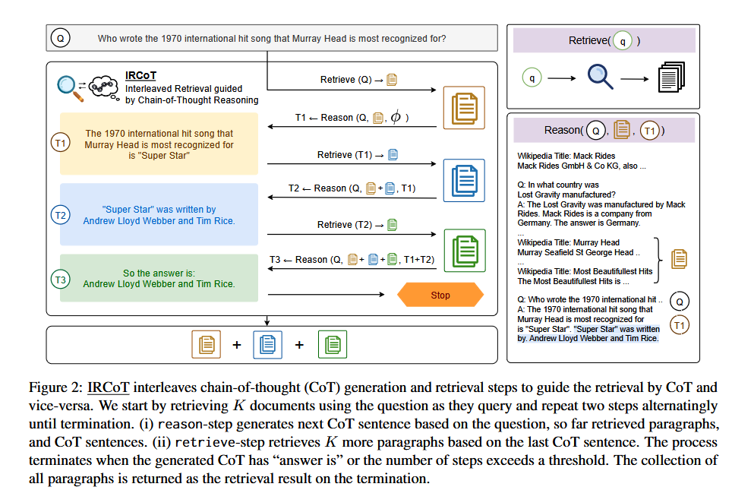
Methodology: RAG

Slide 36
Result
IRCOT

Slide 37
Conclusion
After the above experiments, here is some key results
Selected top 3 LLMs for this project
Gemma 2 9B it
Llama 3.2 11B Instruct
Yi 1.5 9B Chat
RAG method has better accuracy than No RAG method in this project
Self-Reflective RAG has better accuracy and generation quality than RAG, but it costs longer response time

Slide 38
Challenge for this project
Long Response Time for Multiple Interactions
the acceptable response time of the project is lower than 10 seconds
the latency time using self-reflective RAG usually takes more than one minute for each response
Hardware Limitations
Response time of Gemma 2 on provided GPU server (Nvidia 1080 Ti) using basic RAG method: 16.37s per response
Response time of Gemma 2 on cloud server (POE) using basic RAG method: 1s per response

Slide 39
Further Prospect on Term 2
Research on other advanced RAG framework at Experiment 2
To improve the accuracy and generation quality, while addressing the tradeoff between accuracy and computational efficiency
Fine-tuning the LLMs to enhance its RAG capabilities
Create 200 questions and answers pairs
To improve the LLM’s ability to generate accurate, factual and relevant responses based on retrieved context
Building the prototypes
To showcase the chatbot system's functionality and capabilities at the end of the project

Slide 40
Reference
[1] Shiyas, A. (2023). Microsoft research project helps languages survive and thrive
[2] Doe, J., & Smith, A. (2024). OpenCoder: The Open Cookbook for Top-Tier Code Large Language Models
[3] Peters, M. E., Neumann, M., Logan, R. L. IV, Schwartz, R., Joshi, V., Singh, S., & Smith, N. A. (2019). Knowledge enhanced contextual word representations
[4] Jin, S., Yu, S., & Kokoromyti, N. (2024). GRAFT: Graph Retrieval Augmented Fine Tuning for Multi-Hop Query Summarization. Stanford University
[5] Vohra, D. K. (2024). A guide to fine-tuning LLMs for improved RAG performance Hyperstack
[6] Zhang, T., Patil, S. G., Jain, N., Shen, S., Zaharia, M., Stoica, I., & Gonzalez, J. E. (2024). RAFT: Adapting Language Model to Domain Specific RAG
[7] Saad-Falcon, J., Khattab, O., Potts, C., & Zaharia, M. (2024). ARES: An Automated Evaluation Framework for Retrieval-Augmented Generation Systems
[8] Ragas. (2024). Faithfulness. Ragas Documentation
[9] Sawarkar, K., Mangal, A., & Solanki, S. R. (2024). Blended RAG: Improving RAG(Retriever-Augmented Generation) Accuracy with Semantic Search and Hybrid Query-Based Retrievers
[10] Lavie, A., & Agarwal, A. (2007). METEOR: An automatic metric for MT evaluation with high levels of correlation with human judgments. In Proceedings of the Second Workshop on Statistical Machine Translation (pp. 228–231). Association for Computational Linguistics.
[11] Asai, A., Wu, Z., Wang, Y., Sil, A., & Hajishirzi, H. (2023). Self-RAG: Learning to Retrieve, Generate, and Critique through Self-Reflection

